Slide 1
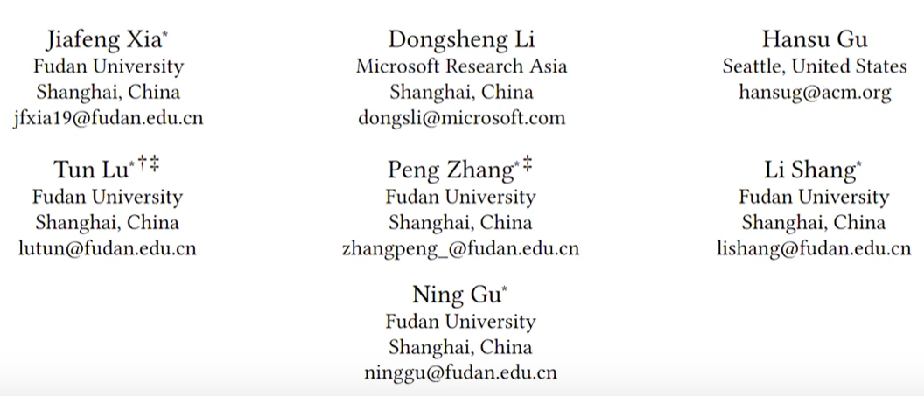
ATAI
Advanced Techniqueof Artificial Intelligence
ATAI
ChongqingUniversity _{AdvancedTechniqueof}
of Technology Artificial Intelligence
Chongqing University of
Technology
Chongqing University ^{ATAI}
_{of Technology} Advanced Techniqueof
Artificial Intelligence
Chongqing University of Technology
Chongqing University of Technology
Hierarchical Graph Signal Processing for Collaborative Filtering
Code: https://github.com/Yaveng/HiGSP.
2024.7. 28•ChongQing
—— WWW 2024
Reported by Ling Tan
1

Slide 2
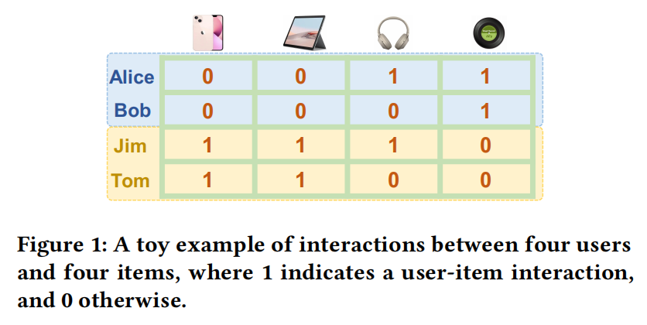
ATAI
AdvancedTechniqueof
Artificial Intelligence
ATAI
ChongqingUniversity _{AdvancedTechniqueof}
of Technology Artificial Intelligence
ChongqingUniversity of Technology
Motivation
（1）Current GSP methods recognize user interaction patterns based on the interactions of all users, so that the recognized interaction patterns are not fully user-matched and easily impacted by other users with different interaction behaviors, resulting in sub-optimal recommendation performance.

Slide 3
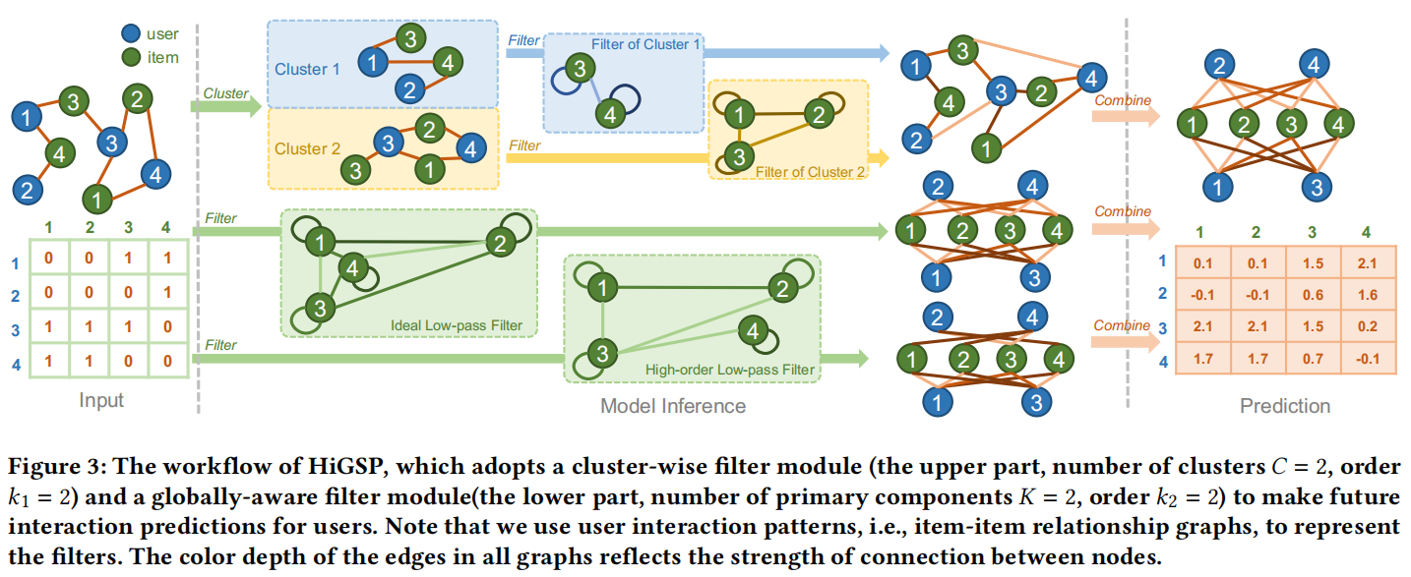
ChongqingUniversity of Technology
ATAI
AdvancedTechniqueof
Artificial Intelligence
ATAI
ChongqingUniversity _{AdvancedTechniqueof}
of Technology Artificial Intelligence
Overview

Slide 4
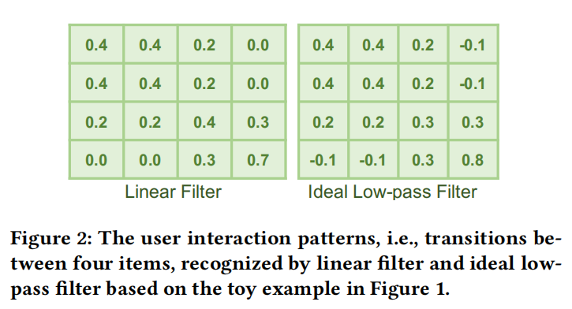
ChongqingUniversity of Technology
ATAI
AdvancedTechniqueof
Artificial Intelligence
ATAI
ChongqingUniversity _{AdvancedTechniqueof}
of Technology Artificial Intelligence
Method
Preliminaries

Slide 5
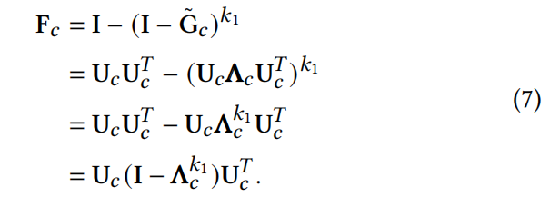
ChongqingUniversity of Technology
ATAI
AdvancedTechniqueof
Artificial Intelligence
ATAI
ChongqingUniversity _{AdvancedTechniqueof}
of Technology Artificial Intelligence
Method

Slide 6
ChongqingUniversity of Technology
ATAI
AdvancedTechniqueof
Artificial Intelligence
ATAI
ChongqingUniversity _{AdvancedTechniqueof}
of Technology Artificial Intelligence
Method

Slide 7
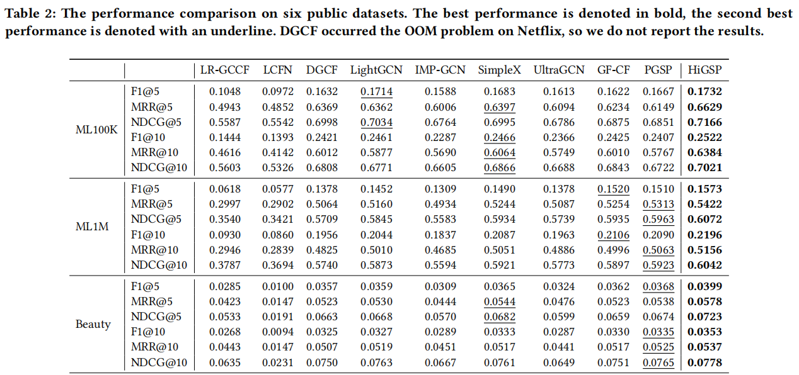
ATAI
AdvancedTechniqueof
Artificial Intelligence
ATAI
ChongqingUniversity _{AdvancedTechniqueof}
of Technology Artificial Intelligence
ChongqingUniversity of Technology
Experiments

Slide 8
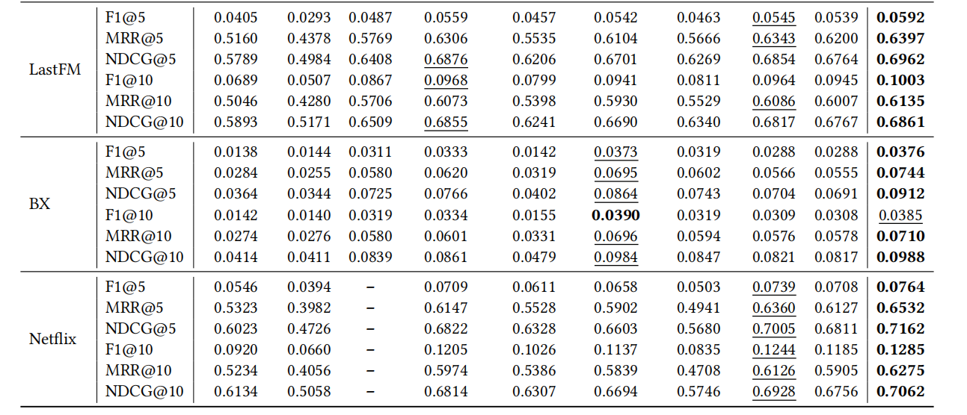
ATAI
AdvancedTechniqueof
Artificial Intelligence
ATAI
ChongqingUniversity _{AdvancedTechniqueof}
of Technology Artificial Intelligence
ChongqingUniversity of Technology
Experiments

Slide 9
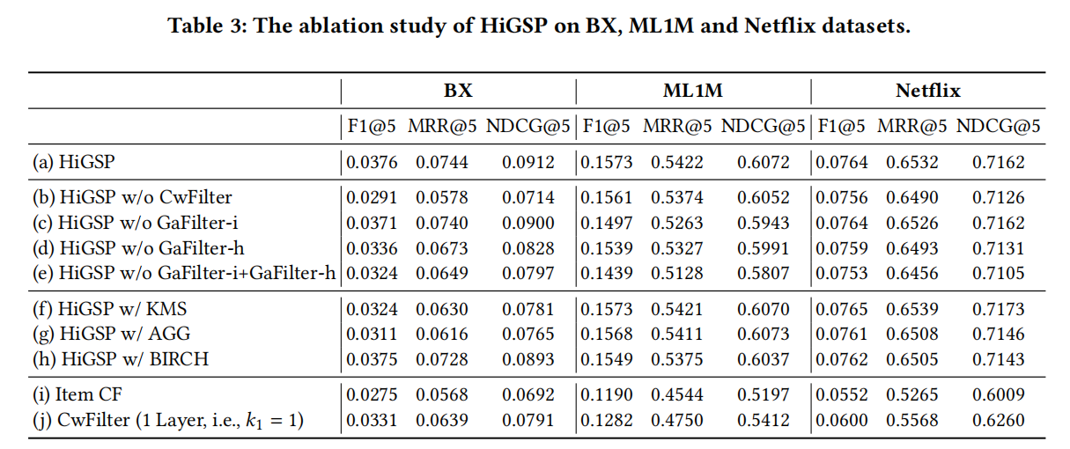
ATAI
AdvancedTechniqueof
Artificial Intelligence
ATAI
ChongqingUniversity _{AdvancedTechniqueof}
of Technology Artificial Intelligence
ChongqingUniversity of Technology
Experiments

Slide 10
ATAI
AdvancedTechniqueof
Artificial Intelligence
ATAI
ChongqingUniversity _{AdvancedTechniqueof}
of Technology Artificial Intelligence
ChongqingUniversity of Technology
Experiments

Slide 11
ATAI
AdvancedTechniqueof
Artificial Intelligence
ATAI
ChongqingUniversity _{AdvancedTechniqueof}
of Technology Artificial Intelligence
ChongqingUniversity of Technology
Experiments

Slide 12
ATAI
AdvancedTechniqueof
Artificial Intelligence
ATAI
ChongqingUniversity _{AdvancedTechniqueof}
of Technology Artificial Intelligence
ChongqingUniversity of Technology
Experiments

Slide 13
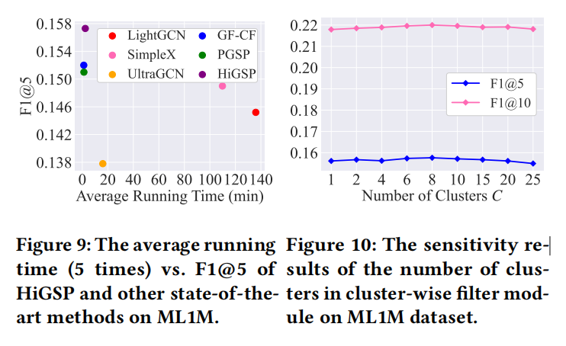
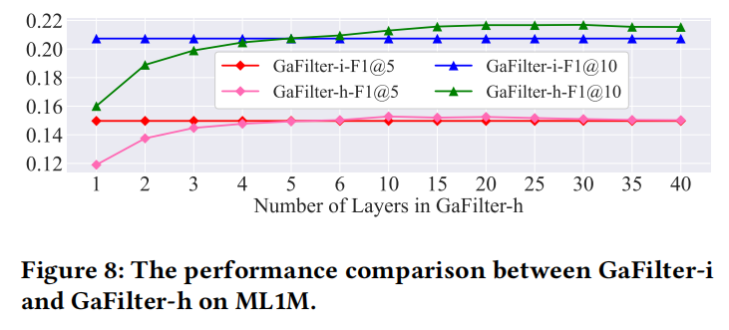
ATAI
AdvancedTechniqueof
Artificial Intelligence
ATAI
ChongqingUniversity _{AdvancedTechniqueof}
of Technology Artificial Intelligence
ChongqingUniversity of Technology
Experiments

Slide 14
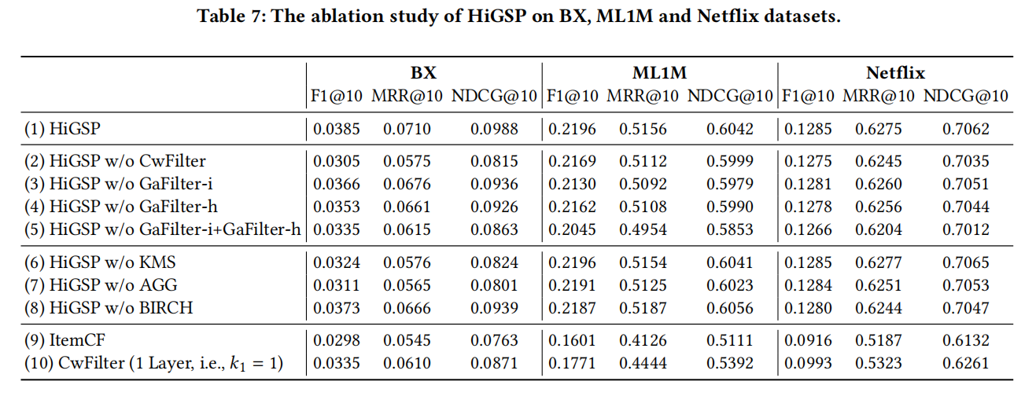
ATAI
AdvancedTechniqueof
Artificial Intelligence
ATAI
ChongqingUniversity _{AdvancedTechniqueof}
of Technology Artificial Intelligence
ChongqingUniversity of Technology
Experiments

Slide 15
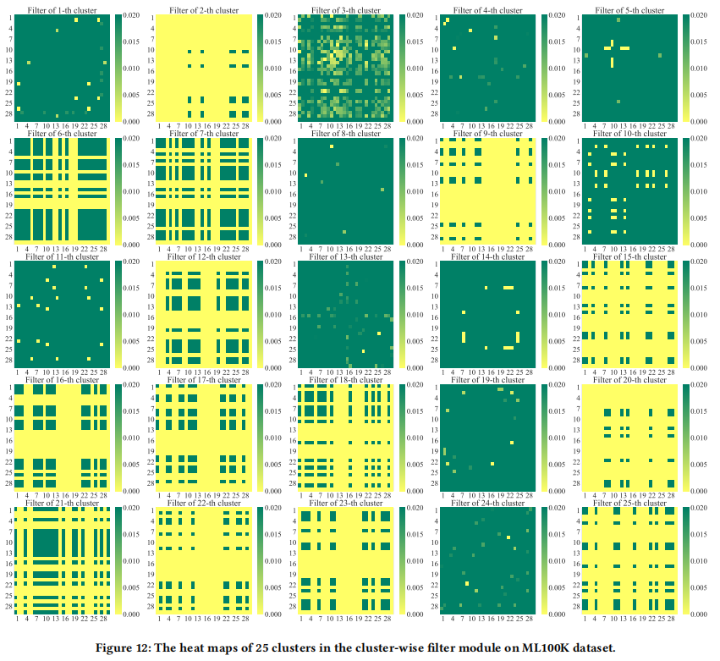
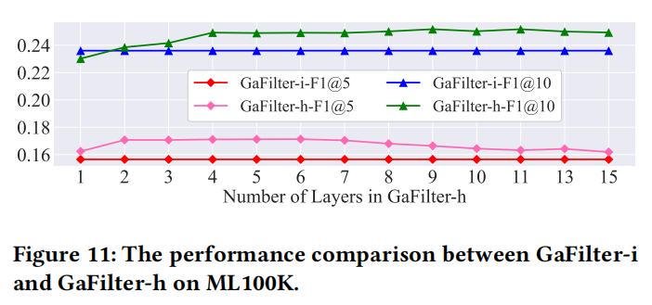
ATAI
AdvancedTechniqueof
Artificial Intelligence
ATAI
ChongqingUniversity _{AdvancedTechniqueof}
of Technology Artificial Intelligence
ChongqingUniversity of Technology
Experiments

Slide 16
ChongqingUniversity of Technology
ATAI
AdvancedTechniqueof
Artificial Intelligence
ATAI
ChongqingUniversity _{AdvancedTechniqueof}
of Technology Artificial Intelligence
Thanks!

